Slide 1
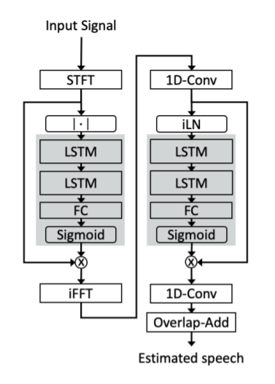
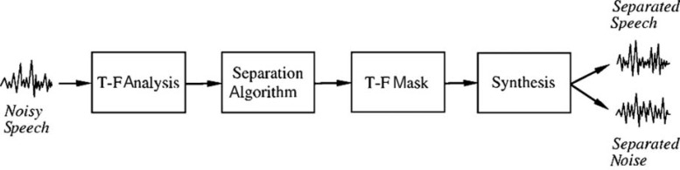
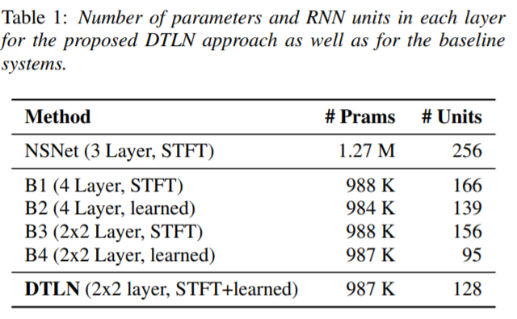
Short-time Fourier transform (STFT)
In speaker separation, a time-frequency masking approach is often chosen to separate the speakers’ signals. Noise suppression is a related source separation problem, but is different in that it only returns the speech signal and discards the noise
instant layer normalization
noise suppression network (NSNet)
Inverse fast Fourier transform
Mean Squared Error between the estimated and clean magnitude STFT of the speech signal

Slide 2
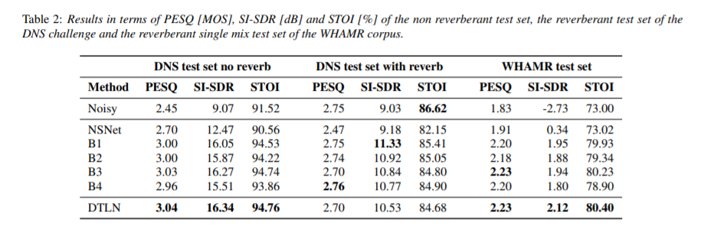
For comparison of the DTLN approach and the baselines, we use three objective measures, i.e., the Perceptual Evaluation of Speech Quality (PESQ) [31], the Scale-Invariant Signal to Distortion Ratio (SI-SDR) [32] and the Short Time Objective Intelligibility measure (STOI) [33]

